Slide 1



PROGRAMMING FUNDAMENTALS IN C
Arrays

Slide 2
Objectives
Introduce 1D array data structure
Introduce character arrays
Introduce multi-dimensional arrays

Slide 3
Content
Arrays
Character arrays
Multi-dimensional arrays
Exercises

Slide 4
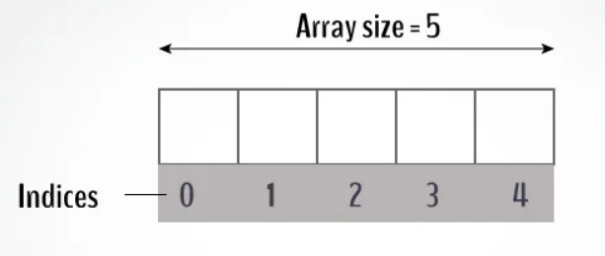
Arrays
Arrays are data structures consisting of related data items of the same type.
An array is a group of contiguous memory locations that all have the same type.
To refer to a particular location or element in the array, we specify the array’s name and the position number of the element in the array.

Slide 5
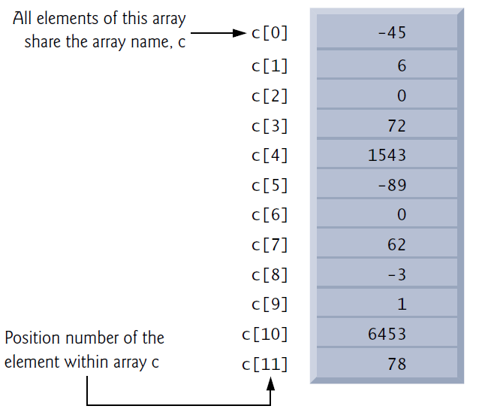
Arrays
Any one of these elements may be referred to by giving the array’s name followed by the position number of the element in square brackets [].

Slide 6

Arrays
Operations:
$c\left[2\right]= 1000;$
$c[a + b] += 2;$
$printf("\%d", c[0] + c[1] + c[2]);$
$x = c[6] / 2;$

Slide 7
Defining Arrays
You specify the type of each element and the number of elements each array requires so that the computer may reserve the appropriate amount of memory.
int c[12];
int b[100], x[27];
int n[5] = { 32, 27, 64, 18, 95 };
int n[10] = { 0 }; // initializes entire array to zeros
int n[] = { 1, 2, 3, 4, 5 };
#include<stdio.h>
#define SIZE 5
int main() {
int s[SIZE];
}
printf("%d\n", n[1]);

Slide 8
Content
Arrays
Character arrays
Multi-dimensional arrays
Exercises

Slide 9
Character Arrays
A string such as "hello" is really an array of individual characters in C.
A character array can be initialized using a string literal
The string "first" contains five characters plus a special string-termination character called the null character.
Thus, array str contains six elements. The escape sequence representing the null character is '\0'.
char str[] = "first";
str[0] str[1] str[2] str[3] str[4] str[5]
‘f’
‘i’
‘r’
‘s’
‘t’
‘\0’

Slide 10

Character Arrays
Character arrays also can be initialized with individual character constants in an initializer list
We also can input a string directly into a character array from the keyboard using $scanf$ and the conversion specifier $\%s$.
A character array representing a string can be output with $printf$ and the %s conversion specifier.
char str[] = { 'f', 'i', 'r', 's', 't', '\0'};
char string2[20];
scanf("%19s", string2);
printf("%s\n", string2);

Slide 11
QUIZ
What happens if the user entered characters more than the array size?
How to determine the size of the array?

Slide 12
Content
Arrays
Character arrays
Multi-dimensional arrays
Exercises

Slide 13
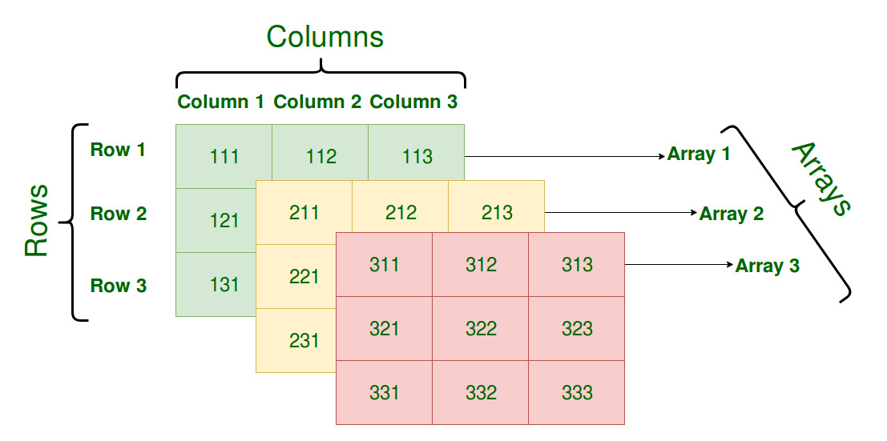
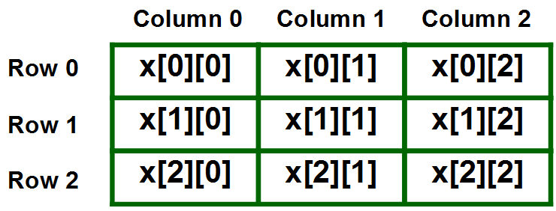
Multi-dimensional Arrays
Arrays can be 1 dimensional, 2 dimensional, 3 dimensional, or more.
We define multidimensional arrays in simple words as array of arrays.

Slide 14
Multi-dimensional Arrays
For 1D array:
Definition
Access
dataType arrayName[arraySize];
int x[5];
int x[5]= {5,3,5,4,9};
arrayName[index];
x[0];

Slide 15
Multi-dimensional Arrays
For 1D array:
Definition
Access
dataType arrayName[arraySize];
int x[5];
int x[5]= {5,3,5,4,9};
arrayName[index];
x[0];

Slide 16
Multi-dimensional Arrays
For 2D array:
Definition
Access
dataType arrayName[rowsNum][columnsNum];
int x[3][3];
int x[3][3] = {{5,3,5}, {4,9,0}, {7,8,9}};
arrayName[rowIndex][columnIndex];
x[0][0];

Slide 17
Multi-dimensional Arrays
For 2D array:
Definition
Access
dataType arrayName[rowsNum][columnsNum];
int x[3][3];
int x[3][3] = {{5,3,5}, {4,9,0}, {7,8,9}};
arrayName[rowIndex][columnIndex];
x[0][0];

Slide 18
Multi-dimensional Arrays
For 2D array:
Definition
Access
dataType arrayName[rowsNum][columnsNum];
int x[3][3];
int x[3][3] = {{5,3,5}, {4,9,0}, {7,8,9}};
arrayName[rowIndex][columnIndex];
x[0][0];

Slide 19
Multi-dimensional Arrays
For 2D array:
Definition
Access
dataType arrayName[rowsNum][columnsNum];
int x[3][3];
int x[3][3] = {{5,3,5}, {4,9,0}, {7,8,9}};
arrayName[rowIndex][columnIndex];
x[0][0];

Slide 20
Multi-dimensional Arrays
For 3D array:
Definition
Columns
dataType arrayName[rowsNum][layersNum][columnsNum];
int x [2][3][4];
0
1
2
3
Layers
int x [2][3][4] =
{
{
{0,1,2,3}, {4,5,6,7}, {8,9,10,11}
},
{
{12,13,14,15}, {16,17,18,19}, {20,21,22,23}
}
};
Rows
4
5
6
7
8
9
10
11
12
13
14
15
19
16
17
18
20
21
22
23

Slide 21
Multi-dimensional Arrays
For 3D array:
Access
Columns
arrayName[rowsNum][layerNum][columnNum];
x [1][2][2];
0
1
2
3
Layers
Rows
4
5
6
7
8
9
10
11
12
13
14
15
19
16
17
18
20
21
22
23

Slide 22
Multi-dimensional Arrays
For 3D array:
Access
Columns
arrayName[rowsNum][layerNum][columnNum];
x [1][2][2];
0
1
2
3
Layers
Rows
4
5
6
7
8
9
10
11
12
13
14
15
19
16
17
18
20
21
22
23

Slide 23
Multi-dimensional Arrays
The general rule, multi-dimensional array is an array of arrays
2D
arr[0]
arr[1]
arr[2]
arr[3]
arr[4]
arr[5]
arr[6]
arr[7]
arr[0]
…
arr[n]
…
arr[0]
…
arr[n]

Slide 24
Multi-dimensional Arrays
The general rule, multi-dimensional array is an array of arrays
3D
arr[0]
arr[1]
arr[2]
arr[3]
arr[4]
arr[5]
arr[6]
arr[7]
arr[0]
…
arr[n]
…
arr[0]
…
arr[n]
arr[0]
…
arr[n]
…
arr[0]
…
arr[n]

Slide 25
Multi-dimensional Arrays
The general rule, multi-dimensional array is an array of arrays
4D
arr[0]
arr[1]
arr[2]
arr[3]
arr[4]
arr[5]
arr[6]
arr[7]
arr[0]
…
arr[n]
…
arr[0]
…
arr[n]
arr[0]
…
arr[n]
…
arr[0]
…
arr[n]
arr[0]
…
arr[n]
…
arr[0]
…
arr[n]

Slide 26
Content
Arrays
Character arrays
Multi-dimensional arrays
Exercises

Slide 27
Exercise 1
Write a C program that prints the data of an array in reverse order. initialize array using the values: {1,2,3,4,5,6,7,8,9}.

Slide 28
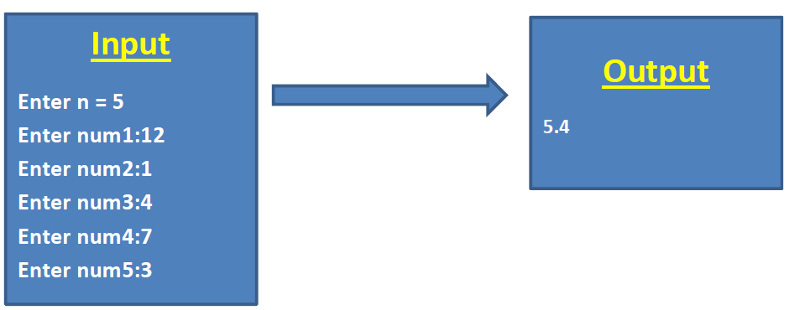
Exercise 2
Write a C program that takes the size of array and its elements from the user then return the average of the elements.

Slide 29
Exercise 3
Write a C program that reads an array and its size and outputs the minimum value

Slide 30
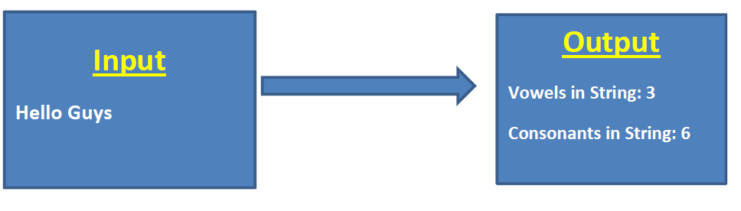
Exercise 4
Write a program that reads a string and determines how many of them are vowels and how many are consonants.

Slide 31
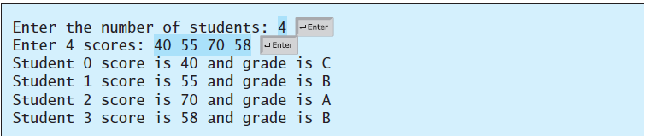
TASK 1
Write a program that reads student scores, gets the best score, and then assigns grades based on the following scheme: Grade is A if score is >= best - 10; Grade is B if score is >= best - 20; Grade is C if score is >= best - 30; Grade is D if score is >= best - 40; Grade is F otherwise. The program prompts the user to enter the total number of students, then prompts the user to enter all the scores and concludes by displaying the grades.

Slide 32
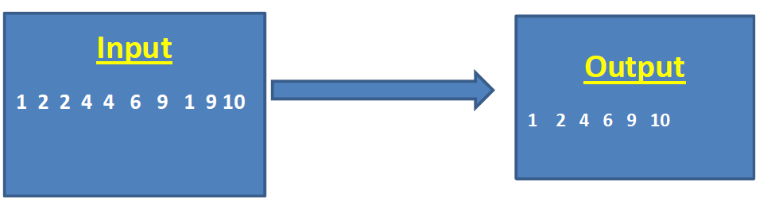
TASK 2
Write a program that reads in 10 numbers and displays distinct numbers (i.e., if a number appears multiple times, it is displayed only once). (Hint: Read a number and store it to an array if it is new. If the number is already in the array, discard it. After the input, the array contains the distinct numbers.)

